Slide 1
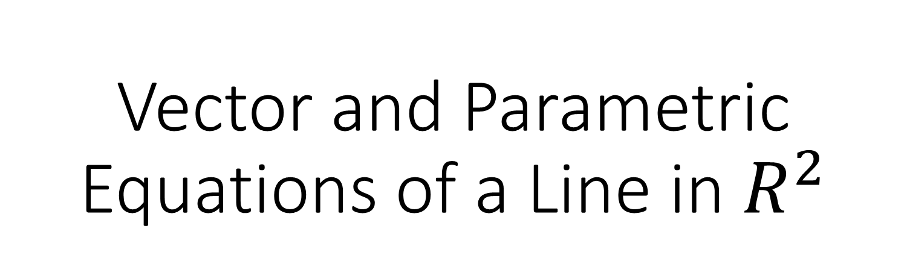
Vector and Parametric Equations of a Line in $R^{2}$

Slide 2
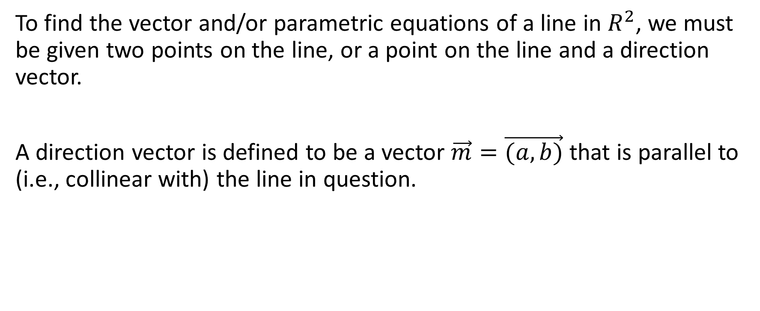
To find the vector and/or parametric equations of a line in $R^{2}$, we must be given two points on the line, or a point on the line and a direction vector.
A direction vector is defined to be a vector $\vec{m}=\vec{(a,b)}$ that is parallel to (i.e., collinear with) the line in question.

Slide 3

Example
Sketch the line that has the point (3,-2) on it, with the direction vector $\vec{m}=\vec{(4,−1)}$.

Slide 4
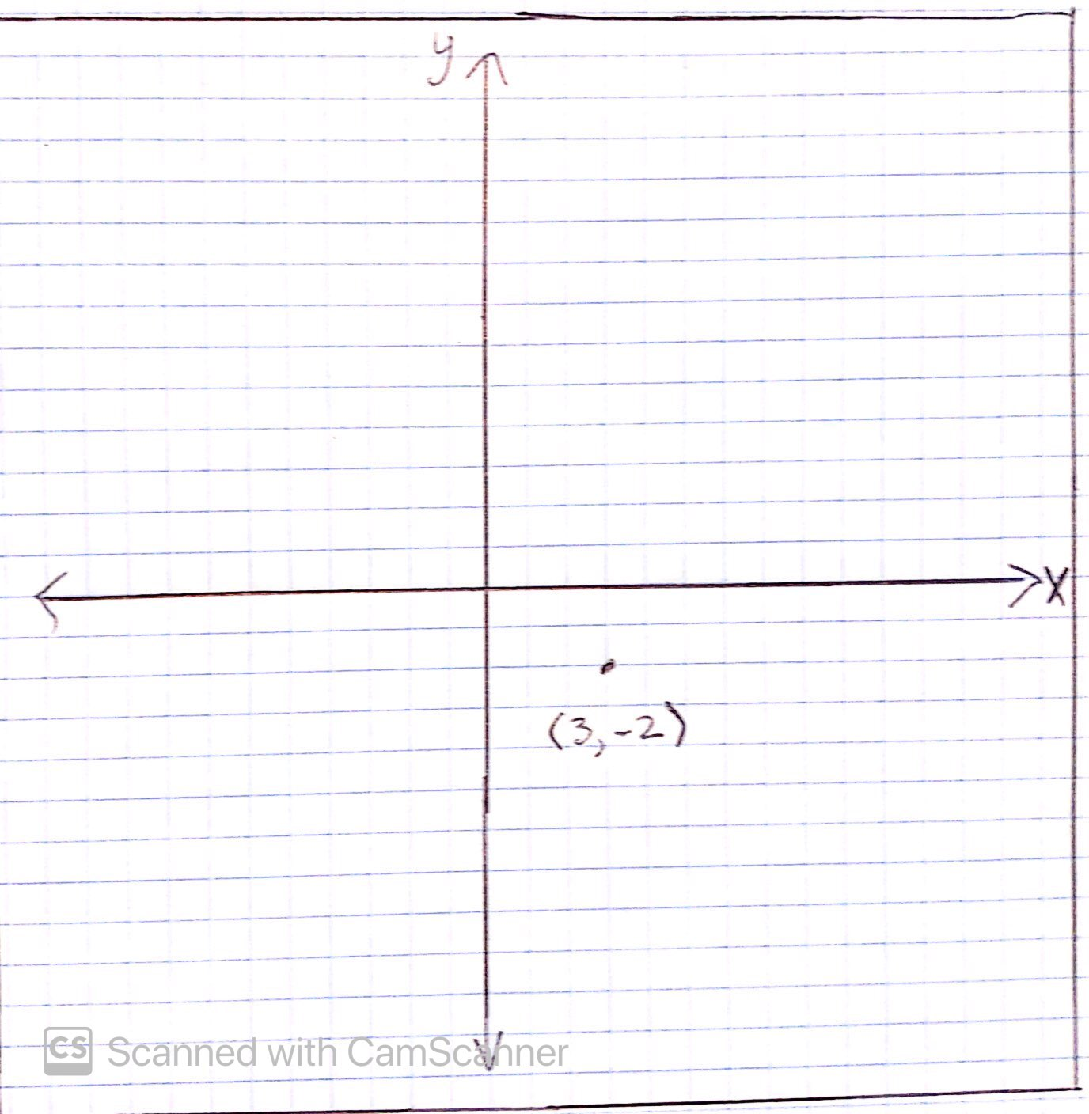
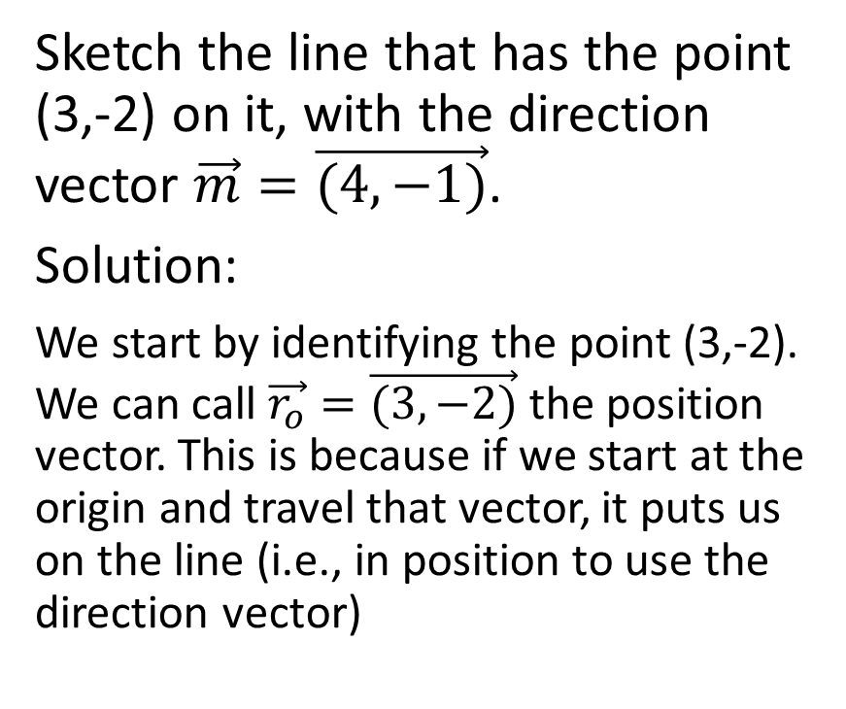
Sketch the line that has the point (3,-2) on it, with the direction vector $\vec{m}=\vec{(4,−1)}$.
Solution:
We start by identifying the point (3,-2). We can call $\vec{r_{o}}=\vec{(3,−2)}$ the position vector. This is because if we start at the origin and travel that vector, it puts us on the line (i.e., in position to use the direction vector)

Slide 5
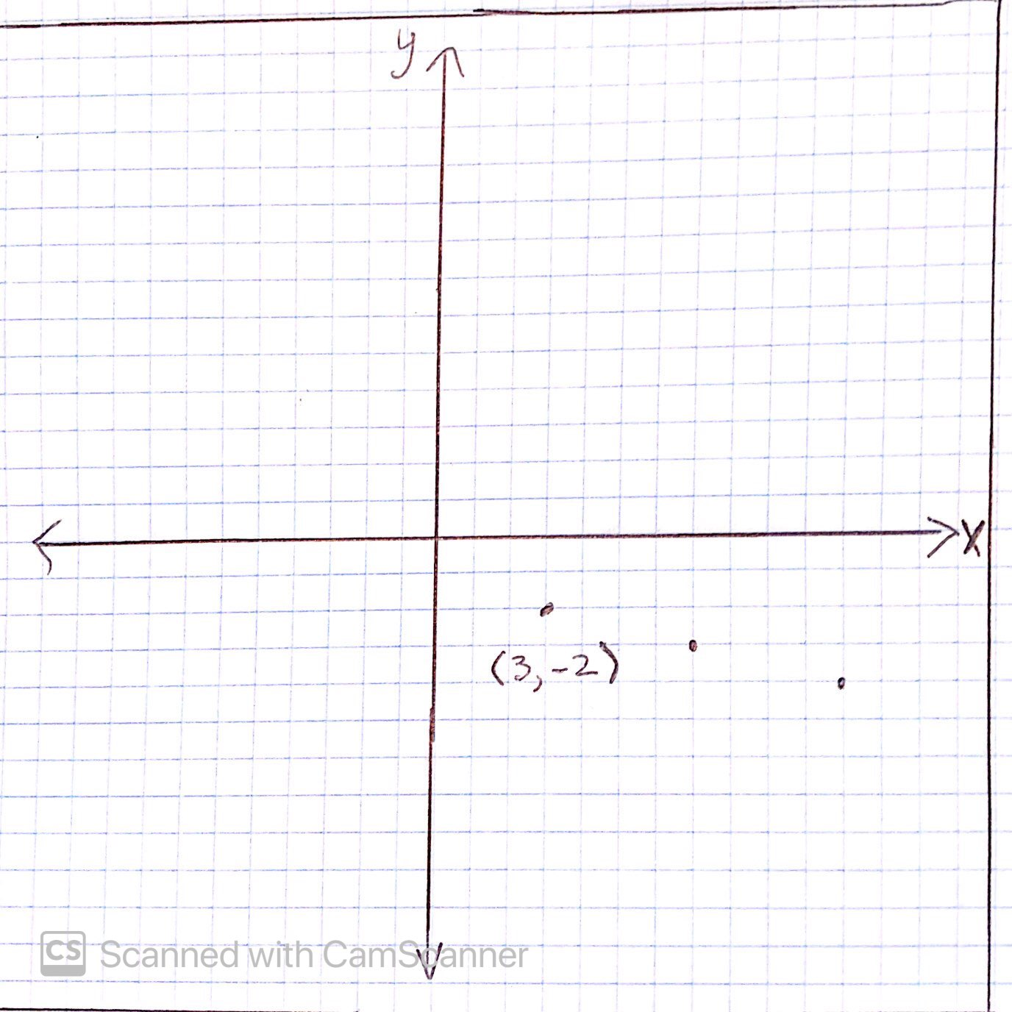
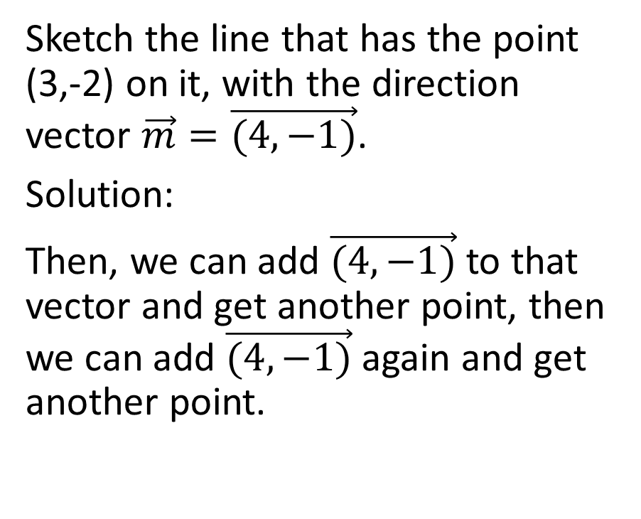
Sketch the line that has the point (3,-2) on it, with the direction vector $\vec{m}=\vec{(4,−1)}$.
Solution:
Then, we can add $\vec{(4,−1)}$ to that vector and get another point, then we can add $\vec{(4,−1)}$ again and get another point.

Slide 6
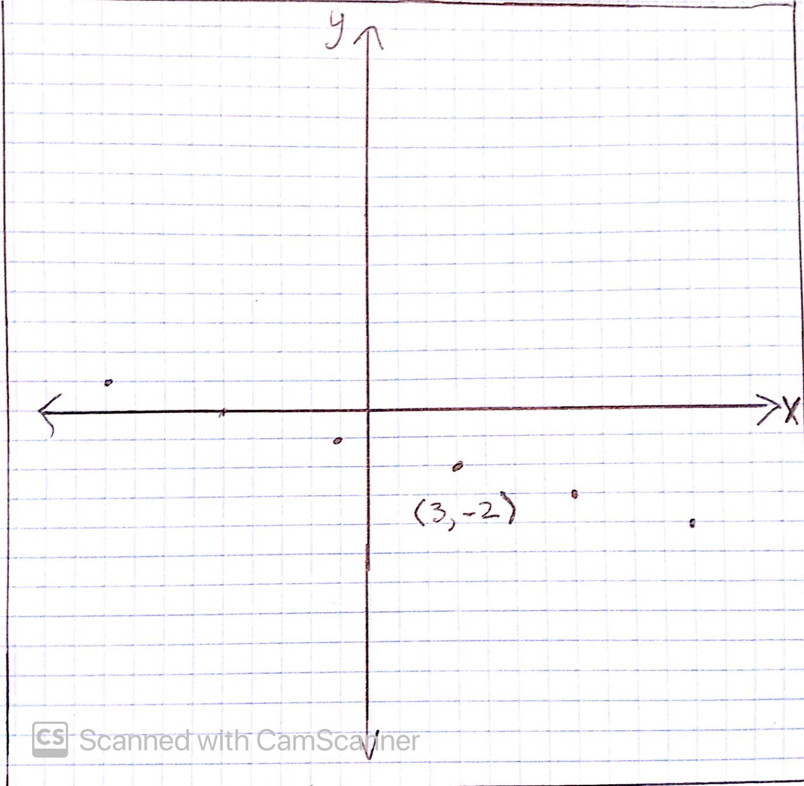
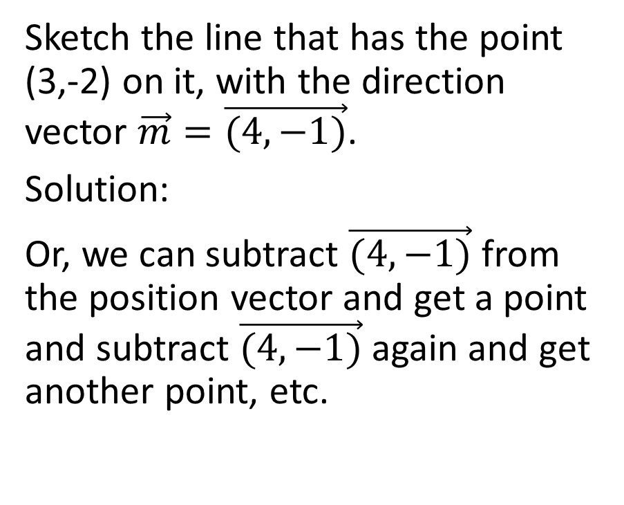
Sketch the line that has the point (3,-2) on it, with the direction vector $\vec{m}=\vec{(4,−1)}$.
Solution:
Or, we can subtract $\vec{(4,−1)}$ from the position vector and get a point and subtract $\vec{(4,−1)}$ again and get another point, etc.

Slide 7
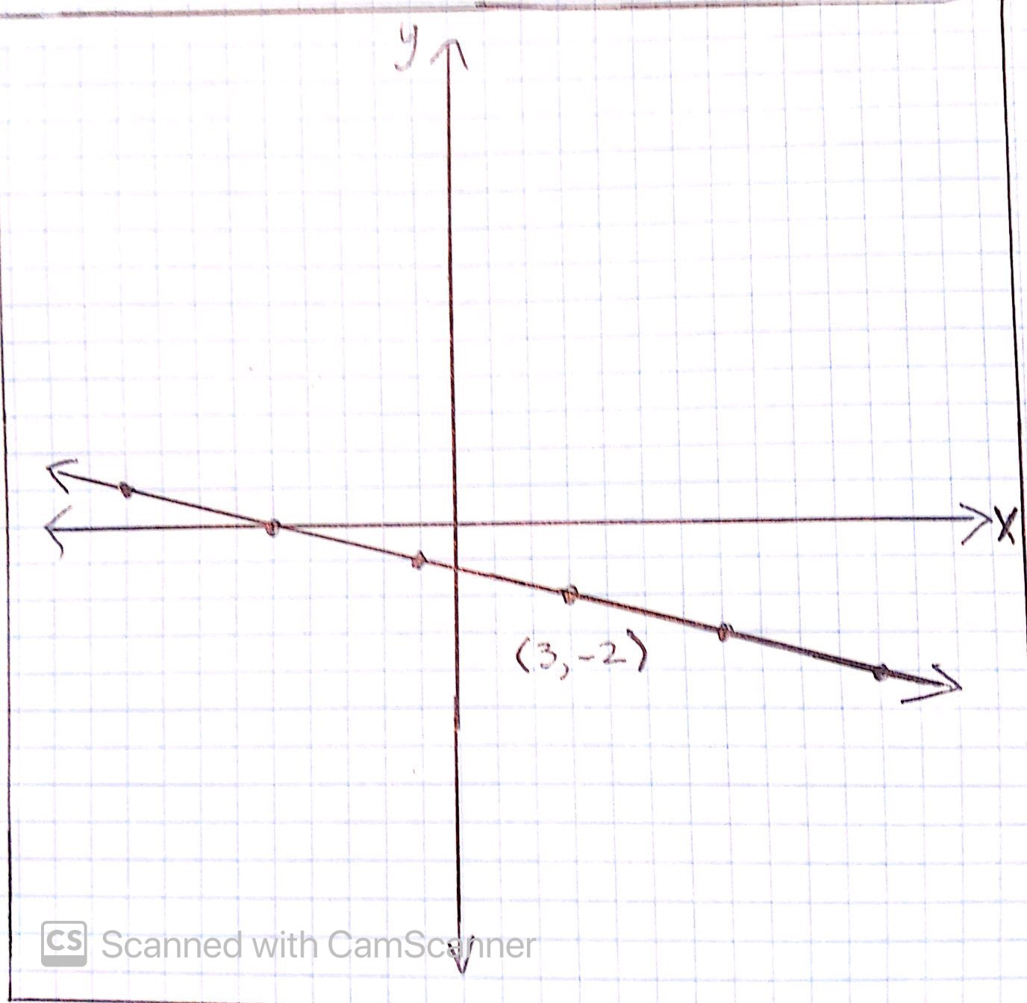
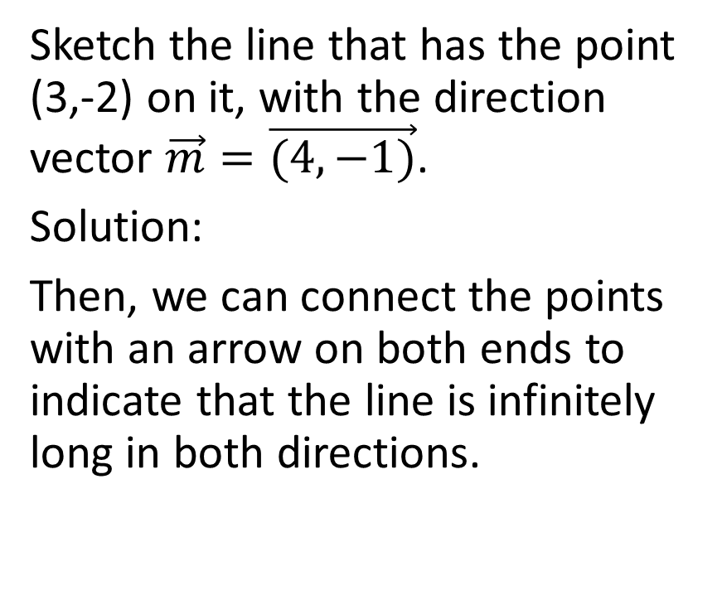
Sketch the line that has the point (3,-2) on it, with the direction vector $\vec{m}=\vec{(4,−1)}$.
Solution:
Then, we can connect the points with an arrow on both ends to indicate that the line is infinitely long in both directions.

Slide 8
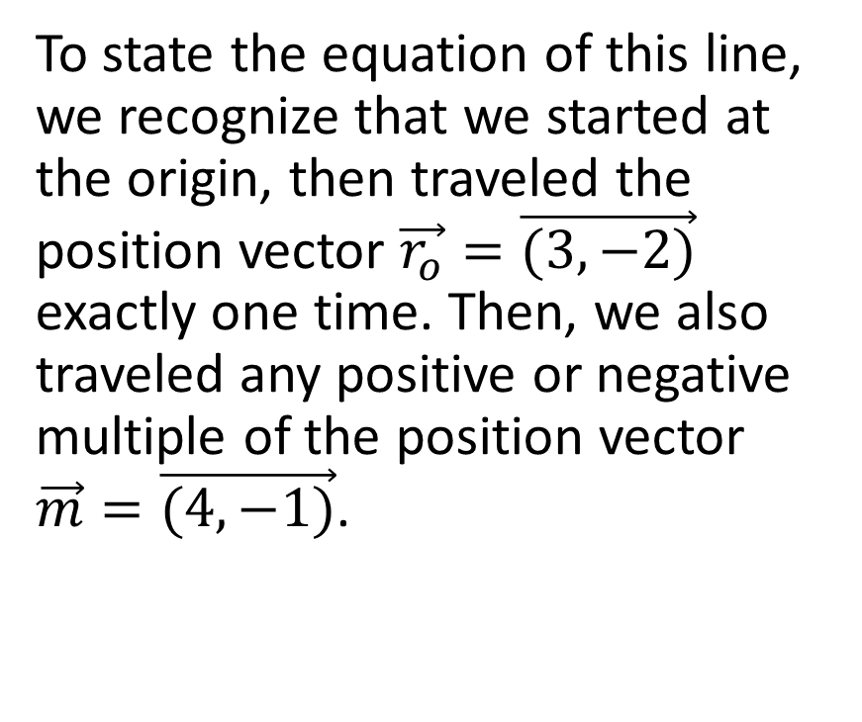
Vector Equation of a Line
To state the equation of this line, we recognize that we started at the origin, then traveled the position vector $\vec{r_{o}}=\vec{(3,−2)}$ exactly one time. Then, we also traveled any positive or negative multiple of the position vector $\vec{m}=\vec{(4,−1)}$.

Slide 9
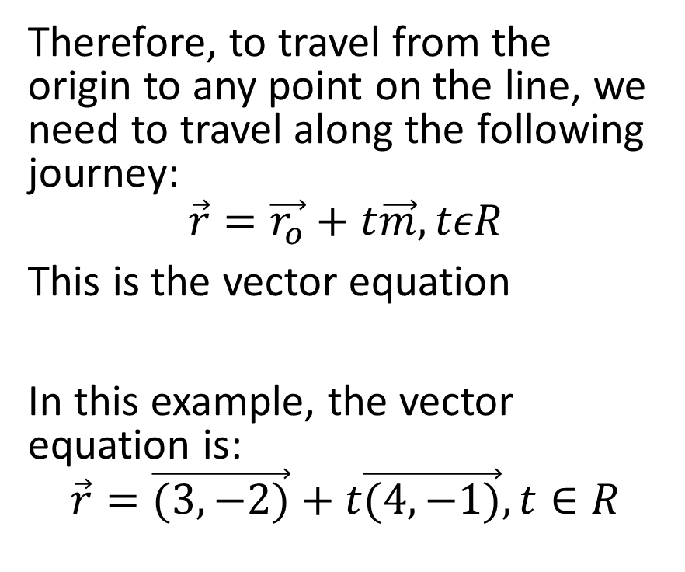
Therefore, to travel from the origin to any point on the line, we need to travel along the following journey:
$$\vec{r}=\vec{r_{o}}+t\vec{m},tεR$$
This is the vector equation
In this example, the vector equation is:
$$\vec{r}=\vec{(3,−2)}+t\vec{(4,−1)},t∈R$$

Slide 10
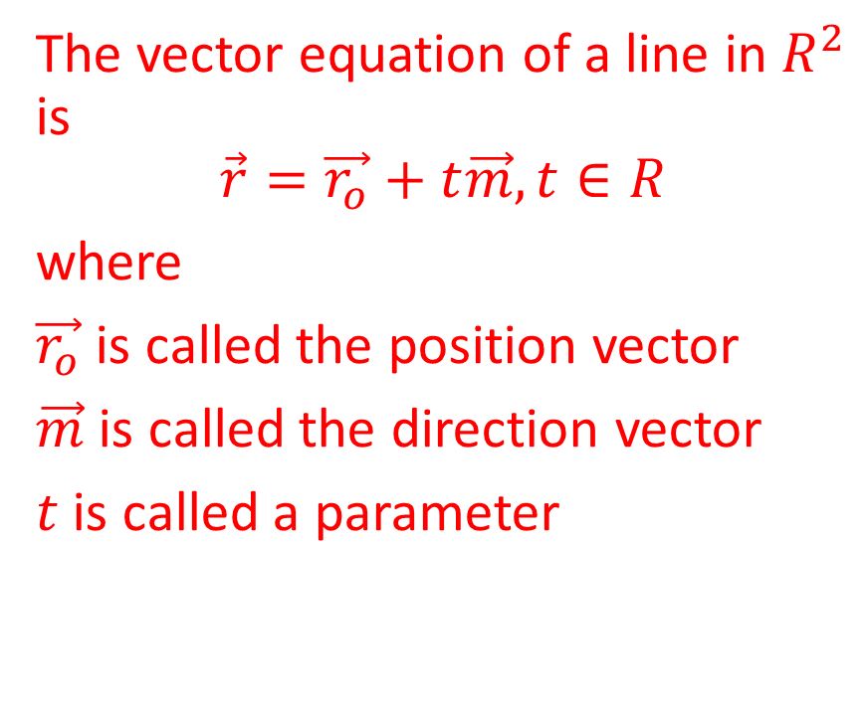
The vector equation of a line in $R^{2}$ is
$$\vec{r}=\vec{r_{o}}+t\vec{m}, t∈R$$
where
$\vec{r_{o}}$ is called the position vector
$\vec{m}$ is called the direction vector
$t$ is called a parameter

Slide 11
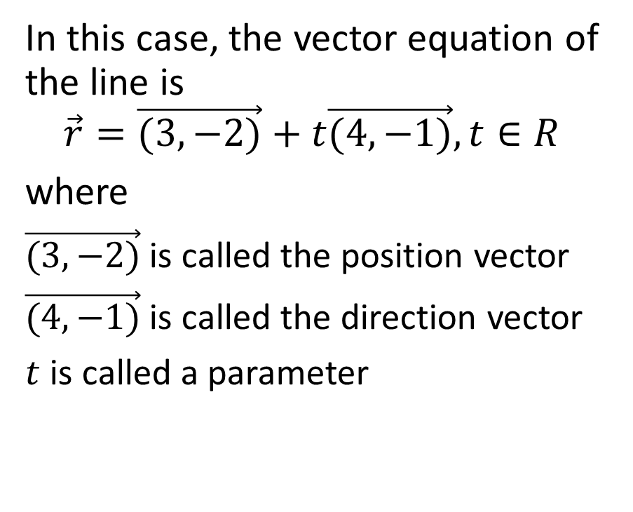
In this case, the vector equation of the line is
$$\vec{r}=\vec{(3,−2)}+t\vec{(4,−1)}, t∈R$$
where
$\vec{(3,−2)}$ is called the position vector
$\vec{(4,−1)}$ is called the direction vector
$t$ is called a parameter

Slide 12
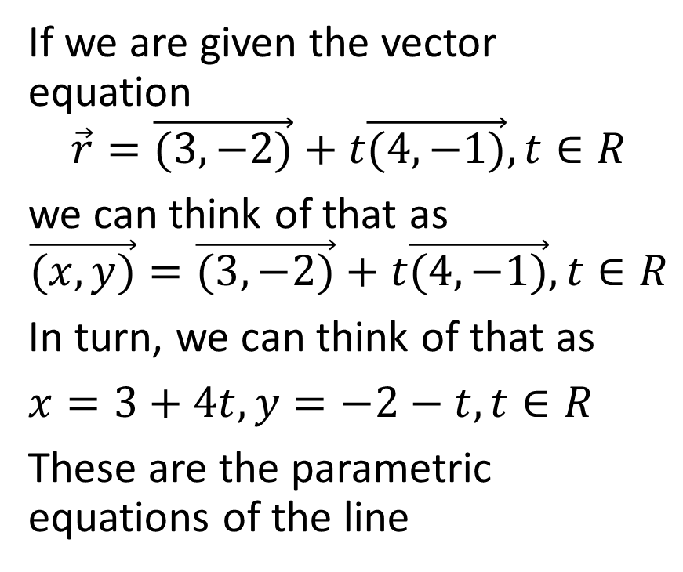
Parametric Equations of a Line
If we are given the vector equation
$$\vec{r}=\vec{(3,−2)}+t\vec{(4,−1)}, t∈R$$
we can think of that as
$$\vec{(x,y)}=\vec{(3,−2)}+t\vec{(4,−1)}, t∈R$$
In turn, we can think of that as
$x=3+4t,y=−2−t,t∈R$
These are the parametric equations of the line

Slide 13

Example 1
Determine the vector and parametric equations of a line passing through the points $(5,−6)$ and $\left(12,−8\right)$.

Slide 14
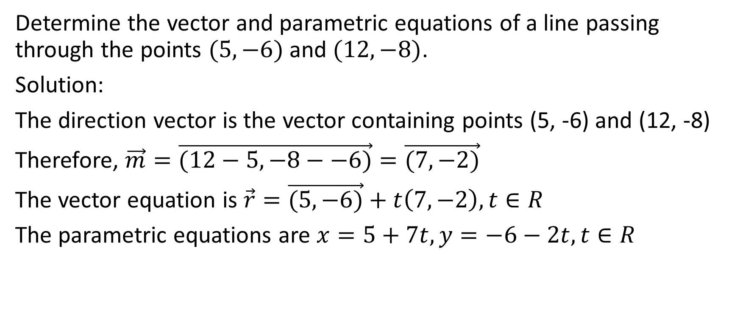
Determine the vector and parametric equations of a line passing through the points $(5,−6)$ and $(12,−8)$.
Solution:
The direction vector is the vector containing points (5, -6) and (12, -8)
Therefore, $\vec{m}=\vec{(12−5,−8−−6)}=\vec{(7,−2)}$
The vector equation is $\vec{r}=\vec{(5,−6)}+t\left(7,−2\right),t∈R$
The parametric equations are $x=5+7t,y=−6−2t,t∈R$

Slide 15

Example 2a
Given the line that you just found in the previous example, i.e., with vector equation $\vec{r}=\vec{(5,−6)}+t\left(7,−2\right),t∈R$ and parametric equations $x=5+7t,y=−6−2t,t∈R$, determine two more points on the line.

Slide 16
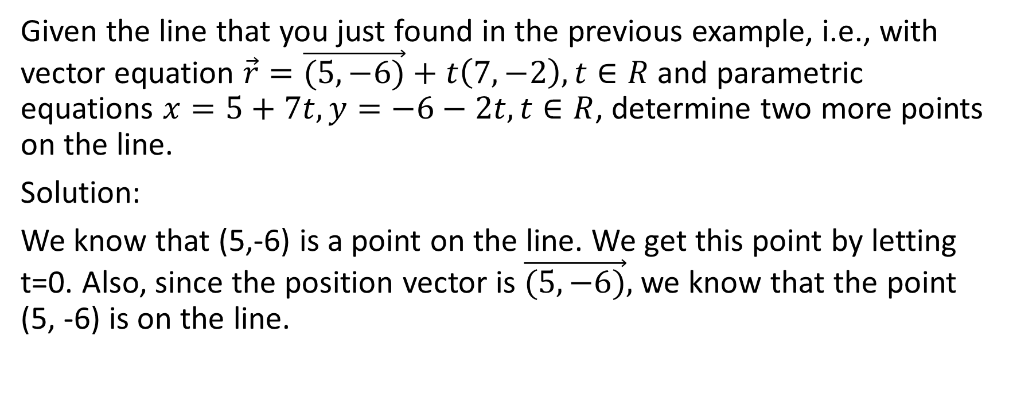
Given the line that you just found in the previous example, i.e., with vector equation $\vec{r}=\vec{(5,−6)}+t\left(7,−2\right),t∈R$ and parametric equations $x=5+7t,y=−6−2t,t∈R$, determine two more points on the line.
Solution:
We know that (5,-6) is a point on the line. We get this point by letting t=0. Also, since the position vector is $\vec{(5,−6)},$we know that the point (5, -6) is on the line.

Slide 17
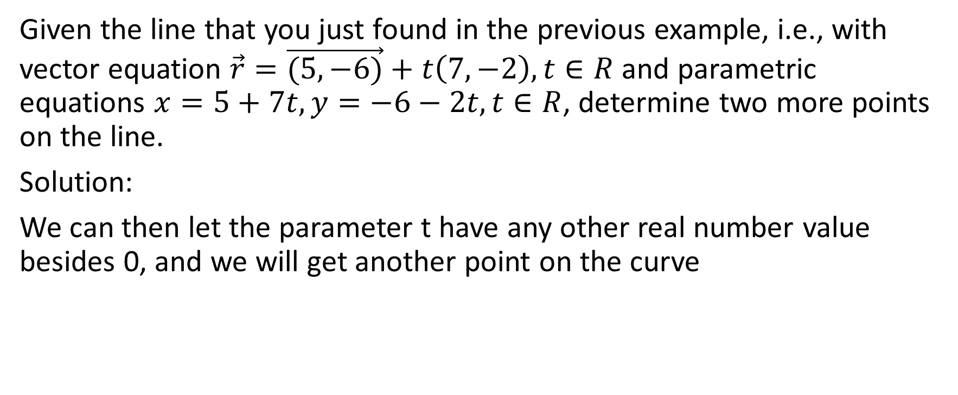
Given the line that you just found in the previous example, i.e., with vector equation $\vec{r}=\vec{(5,−6)}+t\left(7,−2\right),t∈R$ and parametric equations $x=5+7t,y=−6−2t,t∈R$, determine two more points on the line.
Solution:
We can then let the parameter t have any other real number value besides 0, and we will get another point on the curve

Slide 18
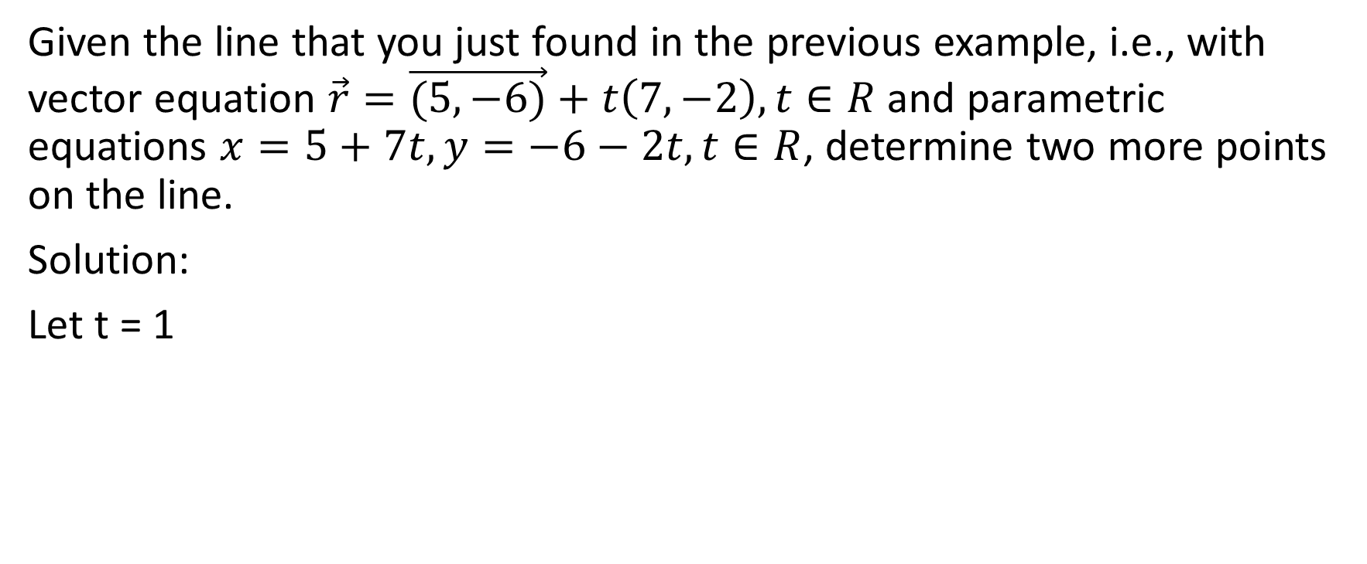
Given the line that you just found in the previous example, i.e., with vector equation $\vec{r}=\vec{(5,−6)}+t\left(7,−2\right),t∈R$ and parametric equations $x=5+7t,y=−6−2t,t∈R$, determine two more points on the line.
Solution:
Let t = 1

Slide 19
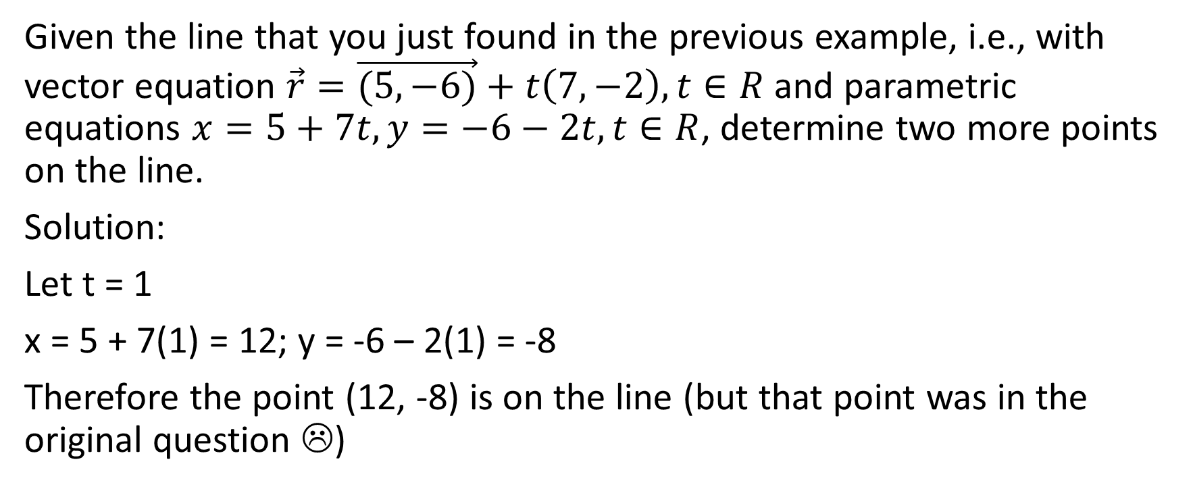
Given the line that you just found in the previous example, i.e., with vector equation $\vec{r}=\vec{(5,−6)}+t\left(7,−2\right),t∈R$ and parametric equations $x=5+7t,y=−6−2t,t∈R$, determine two more points on the line.
Solution:
Let t = 1
x = 5 + 7(1) = 12; y = -6 – 2(1) = -8
Therefore the point (12, -8) is on the line (but that point was in the original question ☹)

Slide 20
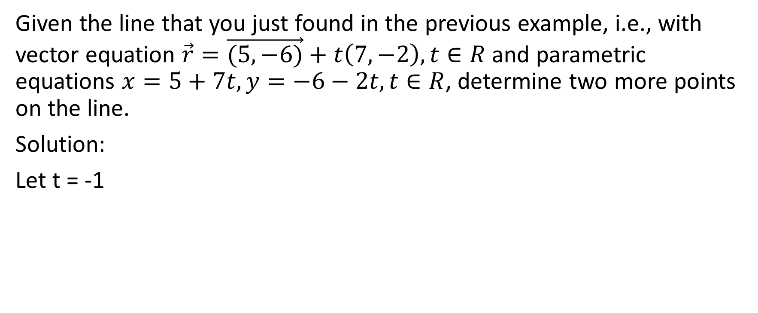
Given the line that you just found in the previous example, i.e., with vector equation $\vec{r}=\vec{(5,−6)}+t\left(7,−2\right),t∈R$ and parametric equations $x=5+7t,y=−6−2t,t∈R$, determine two more points on the line.
Solution:
Let t = -1

Slide 21
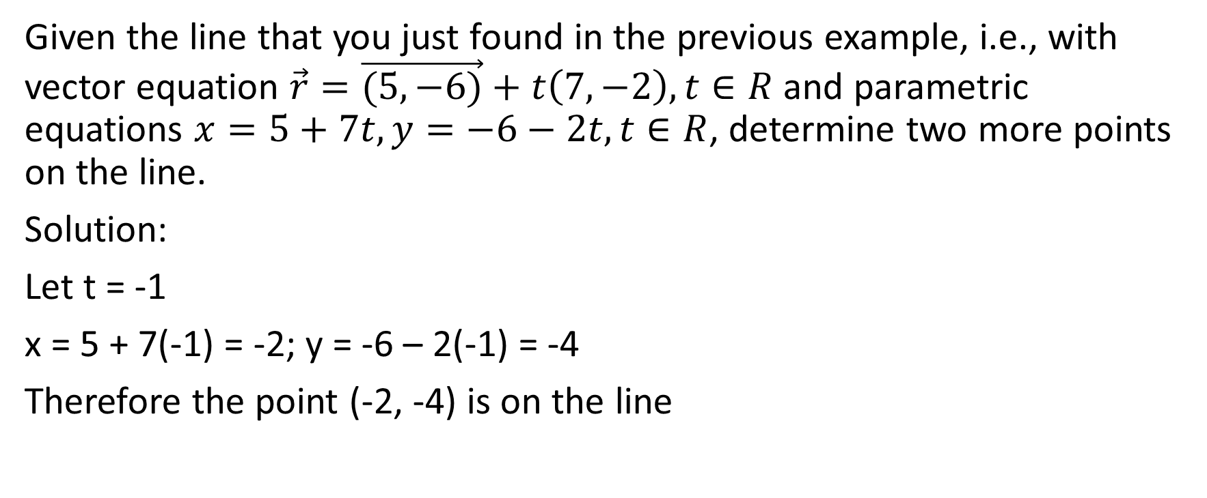
Given the line that you just found in the previous example, i.e., with vector equation $\vec{r}=\vec{(5,−6)}+t\left(7,−2\right),t∈R$ and parametric equations $x=5+7t,y=−6−2t,t∈R$, determine two more points on the line.
Solution:
Let t = -1
x = 5 + 7(-1) = -2; y = -6 – 2(-1) = -4
Therefore the point (-2, -4) is on the line

Slide 22
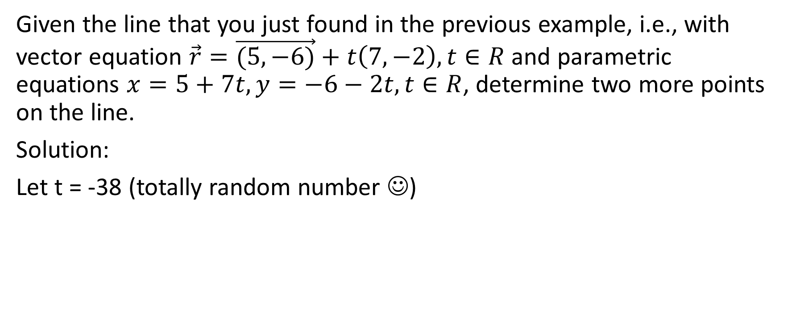
Given the line that you just found in the previous example, i.e., with vector equation $\vec{r}=\vec{(5,−6)}+t\left(7,−2\right),t∈R$ and parametric equations $x=5+7t,y=−6−2t,t∈R$, determine two more points on the line.
Solution:
Let t = -38 (totally random number ☺)

Slide 23
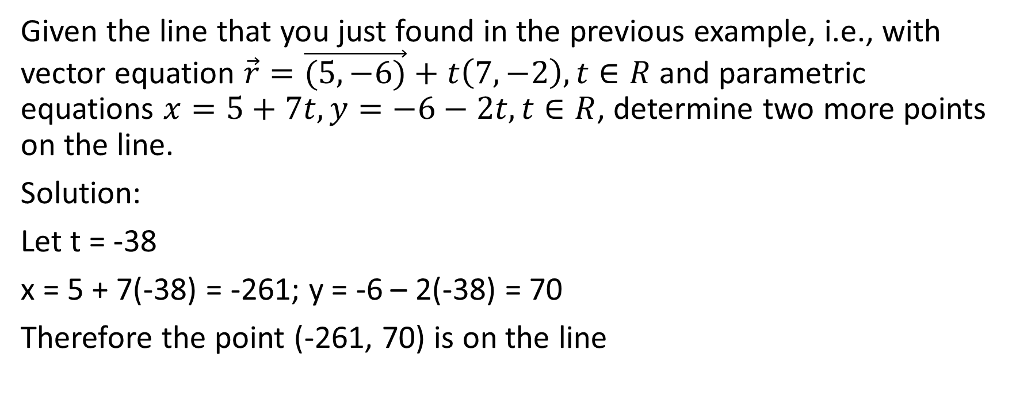
Given the line that you just found in the previous example, i.e., with vector equation $\vec{r}=\vec{(5,−6)}+t\left(7,−2\right),t∈R$ and parametric equations $x=5+7t,y=−6−2t,t∈R$, determine two more points on the line.
Solution:
Let t = -38
x = 5 + 7(-38) = -261; y = -6 – 2(-38) = 70
Therefore the point (-261, 70) is on the line

Slide 24
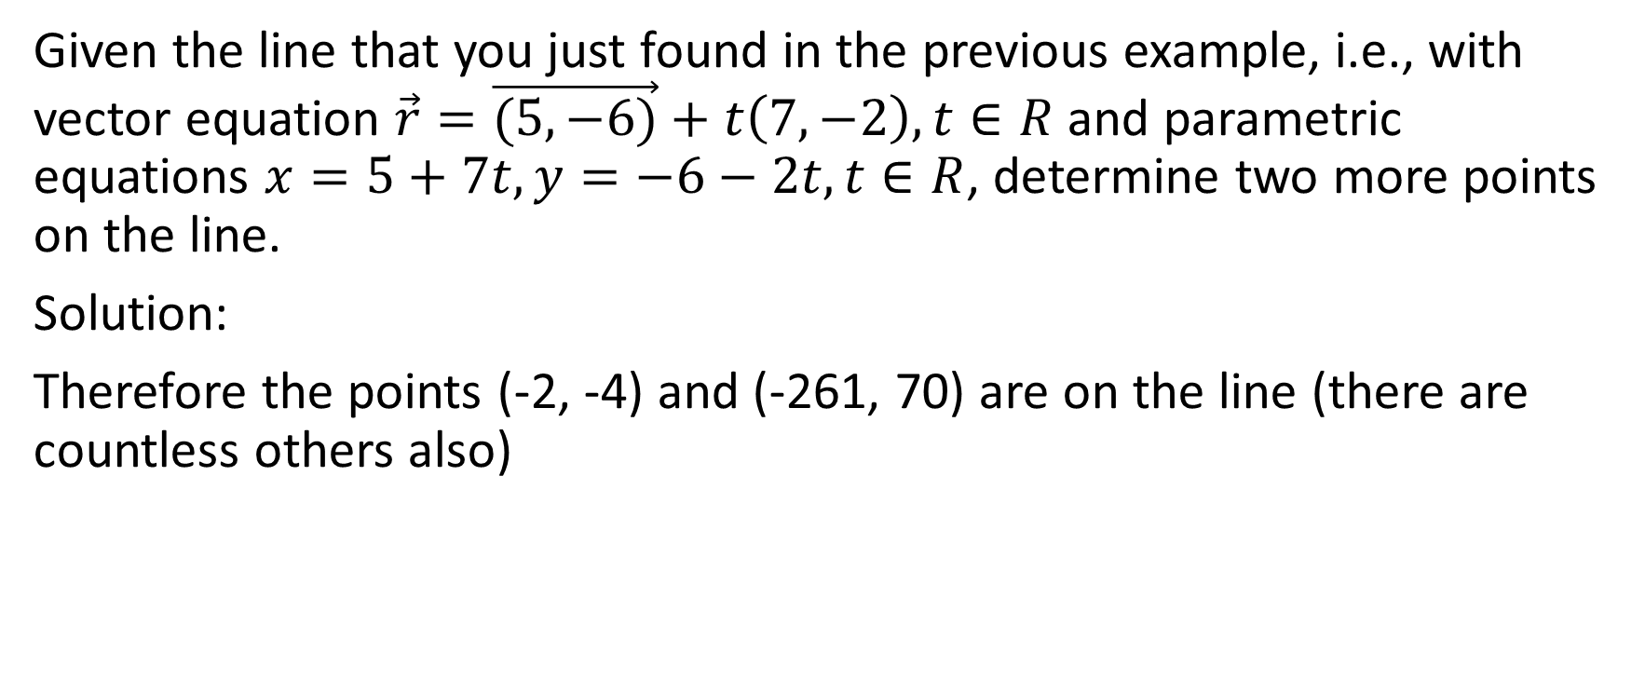
Given the line that you just found in the previous example, i.e., with vector equation $\vec{r}=\vec{(5,−6)}+t\left(7,−2\right),t∈R$ and parametric equations $x=5+7t,y=−6−2t,t∈R$, determine two more points on the line.
Solution:
Therefore the points (-2, -4) and (-261, 70) are on the line (there are countless others also)

Slide 25

Example 2b
Given the line that you just found in the previous example, i.e., with vector equation $\vec{r}=\vec{(5,−6)}+t\left(7,−2\right),t∈R$ and parametric equations $x=5+7t,y=−6−2t,t∈R$, determine if the points
(26, -12) and (-23, 3) are on the line.

Slide 26
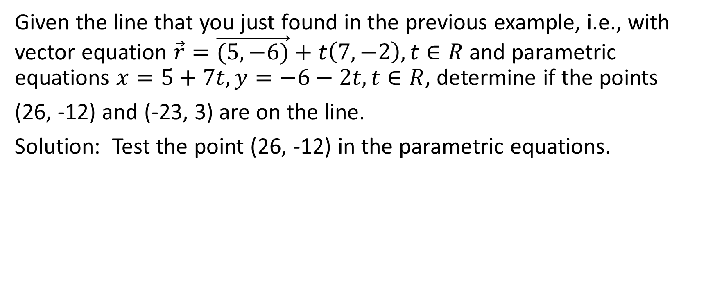
Given the line that you just found in the previous example, i.e., with vector equation $\vec{r}=\vec{(5,−6)}+t\left(7,−2\right),t∈R$ and parametric equations $x=5+7t,y=−6−2t,t∈R$, determine if the points
(26, -12) and (-23, 3) are on the line.
Solution: Test the point (26, -12) in the parametric equations.

Slide 27
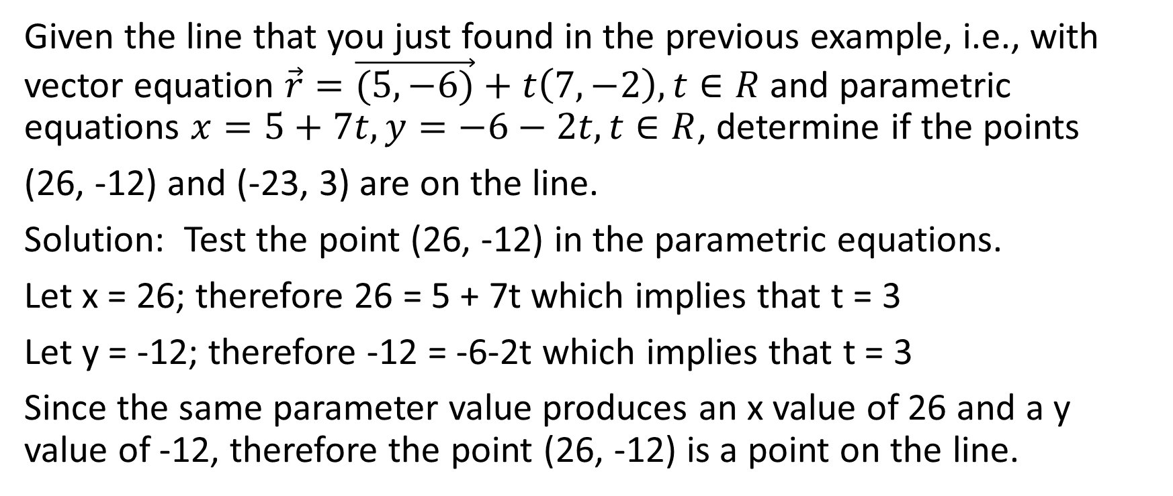
Given the line that you just found in the previous example, i.e., with vector equation $\vec{r}=\vec{(5,−6)}+t\left(7,−2\right),t∈R$ and parametric equations $x=5+7t,y=−6−2t,t∈R$, determine if the points
(26, -12) and (-23, 3) are on the line.
Solution: Test the point (26, -12) in the parametric equations.
Let x = 26; therefore 26 = 5 + 7t which implies that t = 3
Let y = -12; therefore -12 = -6-2t which implies that t = 3
Since the same parameter value produces an x value of 26 and a y value of -12, therefore the point (26, -12) is a point on the line.

Slide 28
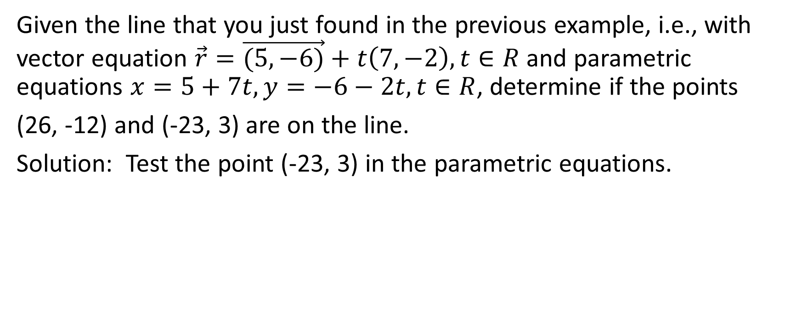
Given the line that you just found in the previous example, i.e., with vector equation $\vec{r}=\vec{(5,−6)}+t\left(7,−2\right),t∈R$ and parametric equations $x=5+7t,y=−6−2t,t∈R$, determine if the points
(26, -12) and (-23, 3) are on the line.
Solution: Test the point (-23, 3) in the parametric equations.

Slide 29
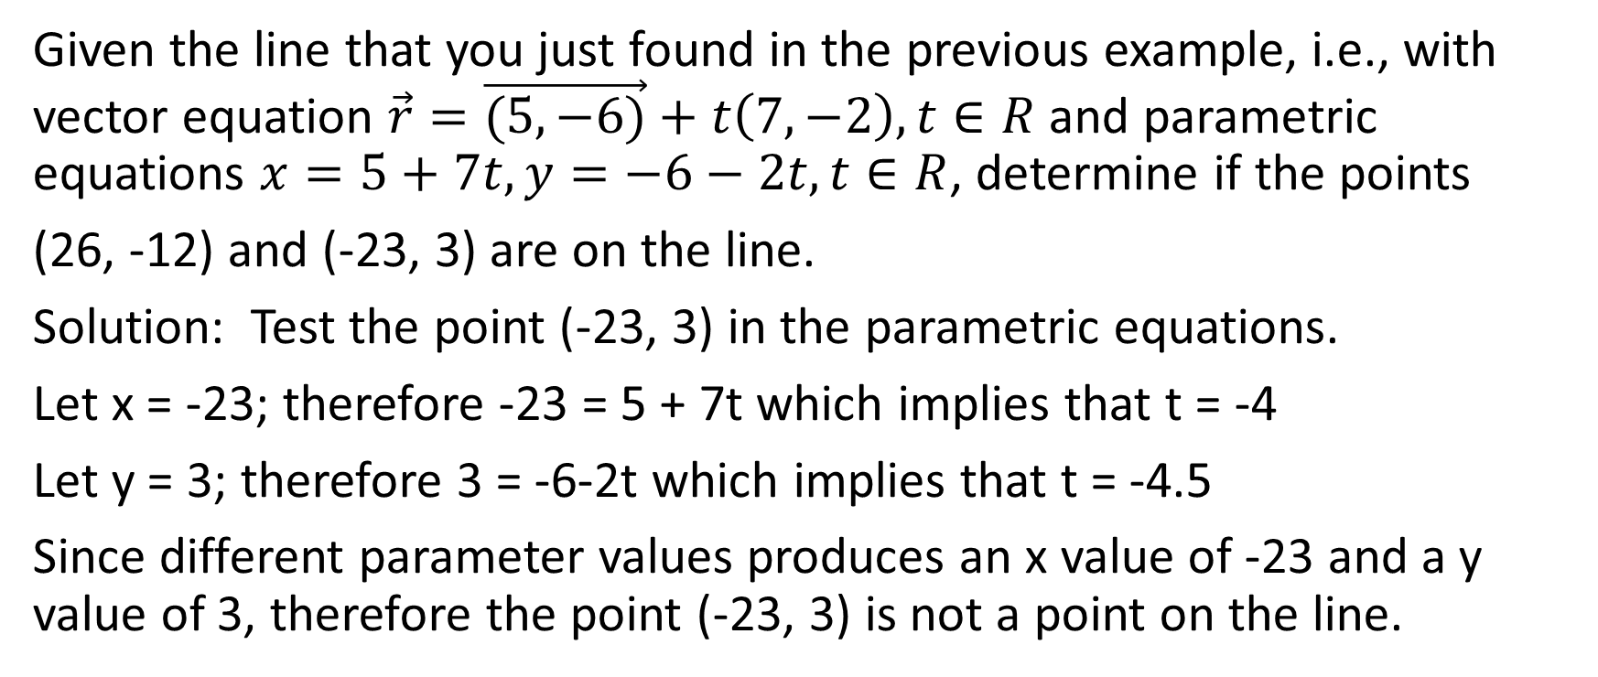
Given the line that you just found in the previous example, i.e., with vector equation $\vec{r}=\vec{(5,−6)}+t\left(7,−2\right),t∈R$ and parametric equations $x=5+7t,y=−6−2t,t∈R$, determine if the points
(26, -12) and (-23, 3) are on the line.
Solution: Test the point (-23, 3) in the parametric equations.
Let x = -23; therefore -23 = 5 + 7t which implies that t = -4
Let y = 3; therefore 3 = -6-2t which implies that t = -4.5
Since different parameter values produces an x value of -23 and a y value of 3, therefore the point (-23, 3) is not a point on the line.

Slide 30

Example 2c
Given the line that you just found in the previous example, i.e., with vector equation $\vec{r}=\vec{(5,−6)}+t\left(7,−2\right),t∈R$ and parametric equations $x=5+7t,y=−6−2t,t∈R$, determine the x and y intercepts of the line

Slide 31
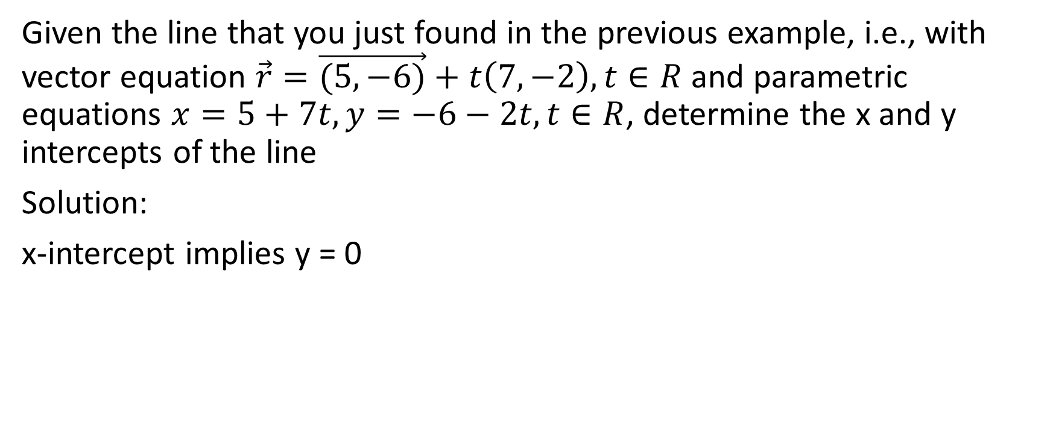
Given the line that you just found in the previous example, i.e., with vector equation $\vec{r}=\vec{(5,−6)}+t\left(7,−2\right),t∈R$ and parametric equations $x=5+7t,y=−6−2t,t∈R$, determine the x and y intercepts of the line
Solution:
x-intercept implies y = 0

Slide 32
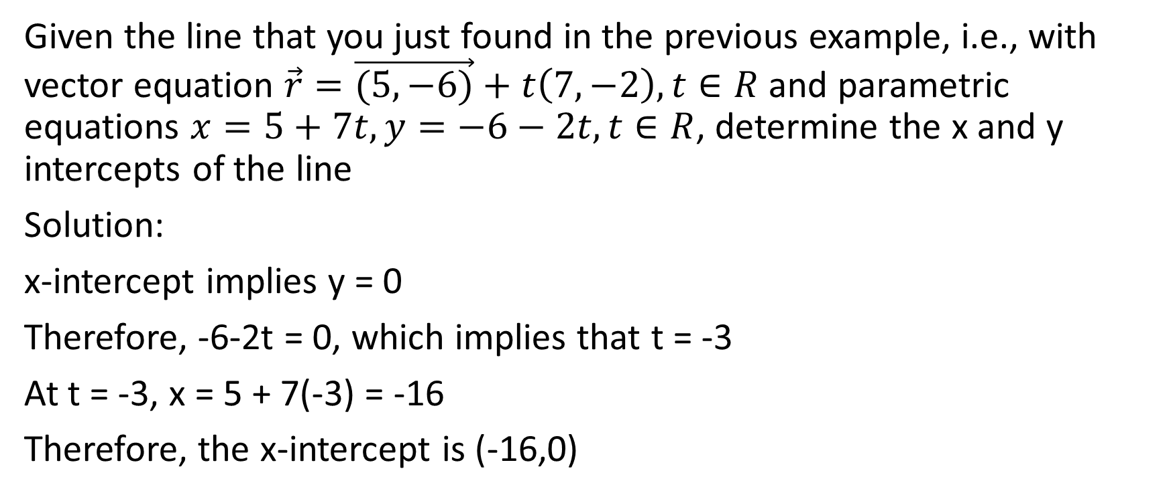
Given the line that you just found in the previous example, i.e., with vector equation $\vec{r}=\vec{(5,−6)}+t\left(7,−2\right),t∈R$ and parametric equations $x=5+7t,y=−6−2t,t∈R$, determine the x and y intercepts of the line
Solution:
x-intercept implies y = 0
Therefore, -6-2t = 0, which implies that t = -3
At t = -3, x = 5 + 7(-3) = -16
Therefore, the x-intercept is (-16,0)

Slide 33
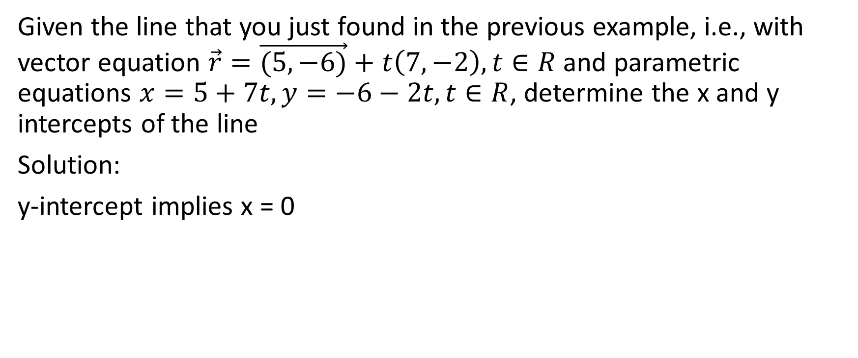
Given the line that you just found in the previous example, i.e., with vector equation $\vec{r}=\vec{(5,−6)}+t\left(7,−2\right),t∈R$ and parametric equations $x=5+7t,y=−6−2t,t∈R$, determine the x and y intercepts of the line
Solution:
y-intercept implies x = 0

Slide 34
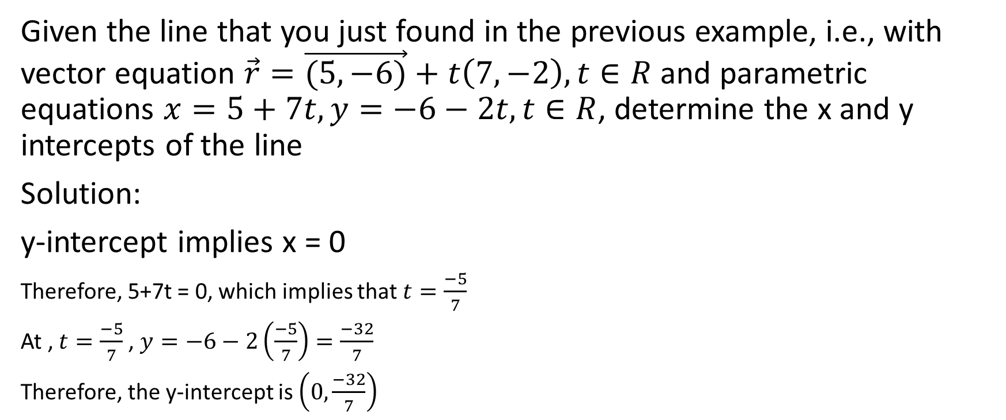
Given the line that you just found in the previous example, i.e., with vector equation $\vec{r}=\vec{(5,−6)}+t\left(7,−2\right),t∈R$ and parametric equations $x=5+7t,y=−6−2t,t∈R$, determine the x and y intercepts of the line
Solution:
y-intercept implies x = 0
Therefore, 5+7t = 0, which implies that $t=\frac{−5}{7}$
At , $t=\frac{−5}{7}$, $y=−6−2\left(\frac{−5}{7}\right)=\frac{−32}{7}$
Therefore, the y-intercept is $\left(0,\frac{−32}{7}\right)$

Slide 35
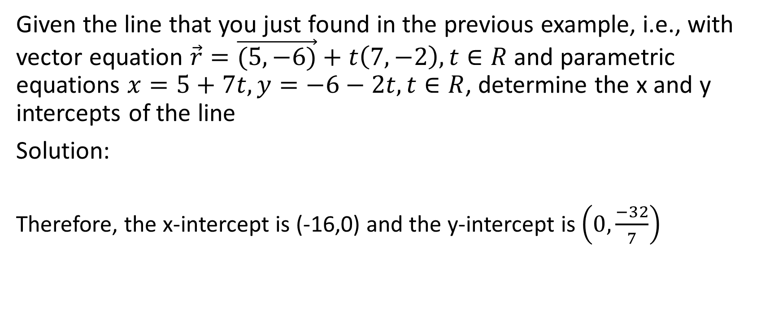
Given the line that you just found in the previous example, i.e., with vector equation $\vec{r}=\vec{(5,−6)}+t\left(7,−2\right),t∈R$ and parametric equations $x=5+7t,y=−6−2t,t∈R$, determine the x and y intercepts of the line
Solution:
Therefore, the x-intercept is (-16,0) and the y-intercept is $\left(0,\frac{−32}{7}\right)$

Slide 36

Example 2d
Given the line that you just found in the previous example, i.e., with vector equation $\vec{r}=\vec{(5,−6)}+t\left(7,−2\right),t∈R$ and parametric equations $x=5+7t,y=−6−2t,t∈R$, if the vector equation $\vec{r}=\vec{(19,−10)}+t\vec{\left(\frac{−7}{2},1\right)}$ could also represent the line.

Slide 37
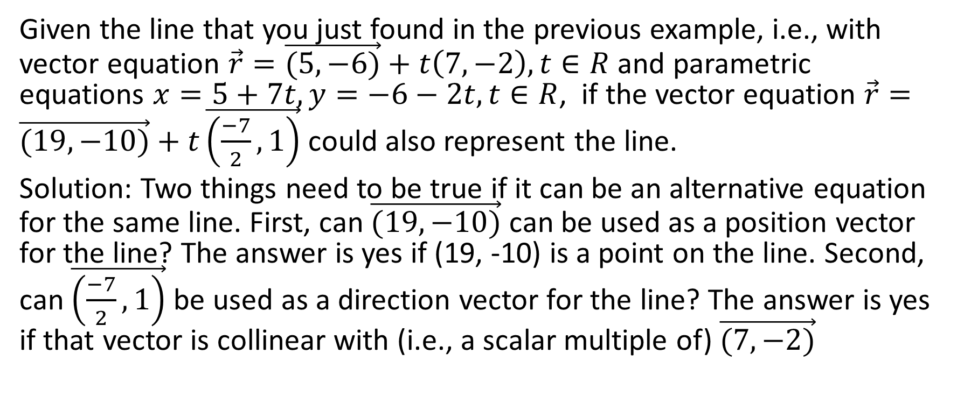
Given the line that you just found in the previous example, i.e., with vector equation $\vec{r}=\vec{(5,−6)}+t\left(7,−2\right),t∈R$ and parametric equations $x=5+7t,y=−6−2t,t∈R$, if the vector equation $\vec{r}=\vec{(19,−10)}+t\vec{\left(\frac{−7}{2},1\right)}$ could also represent the line.
Solution: Two things need to be true if it can be an alternative equation for the same line. First, can $\vec{(19,−10)}$ can be used as a position vector for the line? The answer is yes if (19, -10) is a point on the line. Second, can $\vec{\left(\frac{−7}{2},1\right)}$ be used as a direction vector for the line? The answer is yes if that vector is collinear with (i.e., a scalar multiple of) $\vec{(7,−2)}$

Slide 38
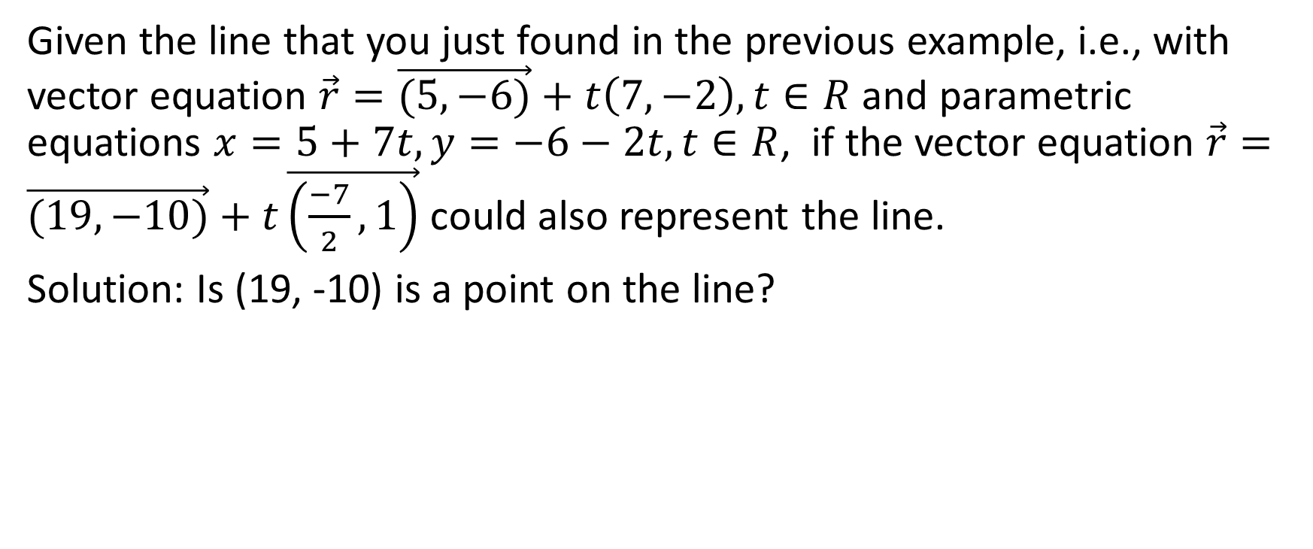
Given the line that you just found in the previous example, i.e., with vector equation $\vec{r}=\vec{(5,−6)}+t\left(7,−2\right),t∈R$ and parametric equations $x=5+7t,y=−6−2t,t∈R$, if the vector equation $\vec{r}=\vec{(19,−10)}+t\vec{\left(\frac{−7}{2},1\right)}$ could also represent the line.
Solution: Is (19, -10) is a point on the line?

Slide 39
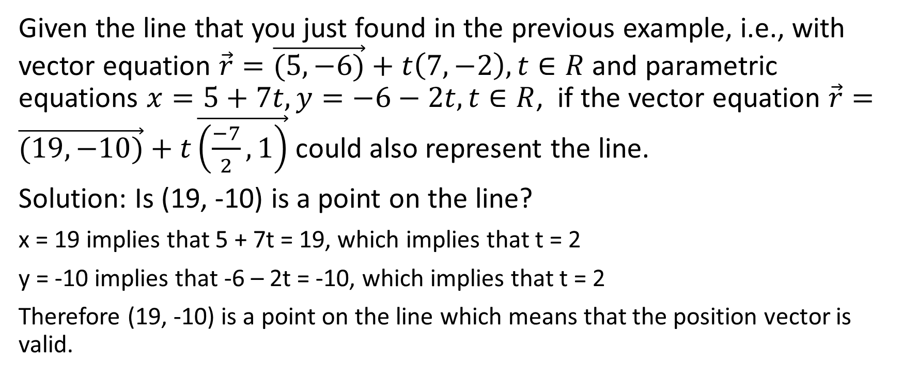
Given the line that you just found in the previous example, i.e., with vector equation $\vec{r}=\vec{(5,−6)}+t\left(7,−2\right),t∈R$ and parametric equations $x=5+7t,y=−6−2t,t∈R$, if the vector equation $\vec{r}=\vec{(19,−10)}+t\vec{\left(\frac{−7}{2},1\right)}$ could also represent the line.
Solution: Is (19, -10) is a point on the line?
x = 19 implies that 5 + 7t = 19, which implies that t = 2
y = -10 implies that -6 – 2t = -10, which implies that t = 2
Therefore (19, -10) is a point on the line which means that the position vector is valid.

Slide 40
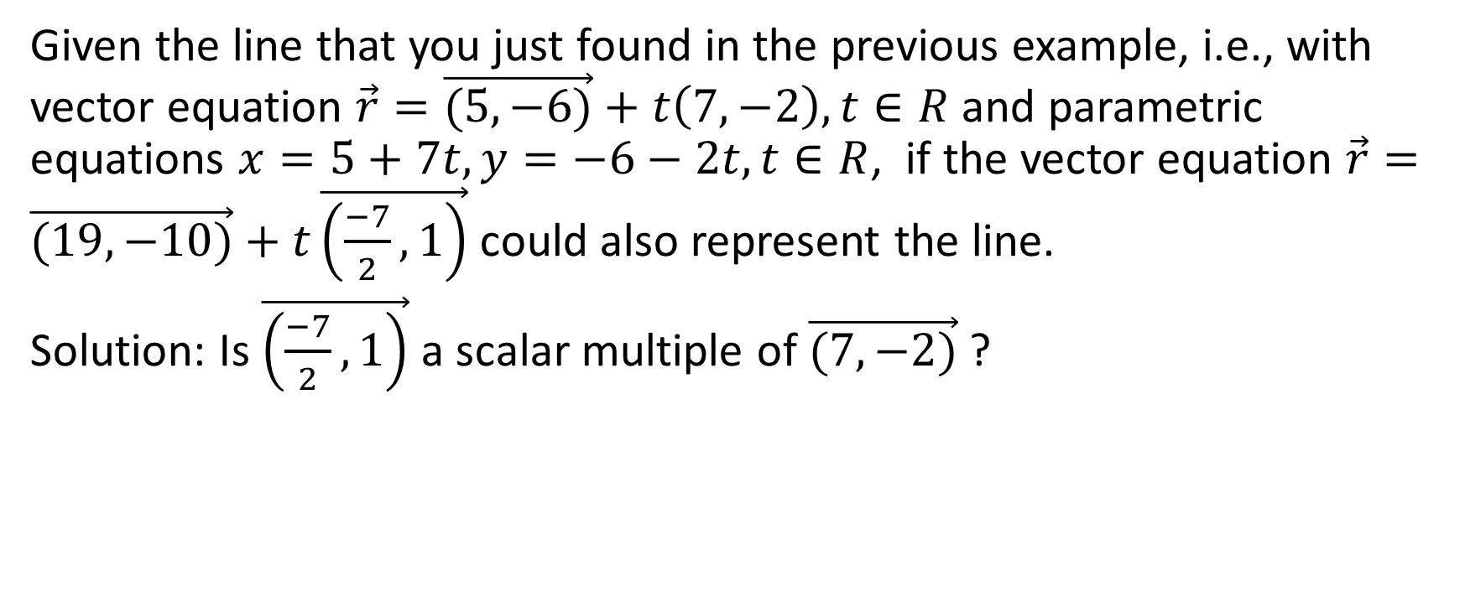
Given the line that you just found in the previous example, i.e., with vector equation $\vec{r}=\vec{(5,−6)}+t\left(7,−2\right),t∈R$ and parametric equations $x=5+7t,y=−6−2t,t∈R$, if the vector equation $\vec{r}=\vec{(19,−10)}+t\vec{\left(\frac{−7}{2},1\right)}$ could also represent the line.
Solution: Is $\vec{\left(\frac{−7}{2},1\right)}$ a scalar multiple of $\vec{(7,−2)}$ ?

Slide 41
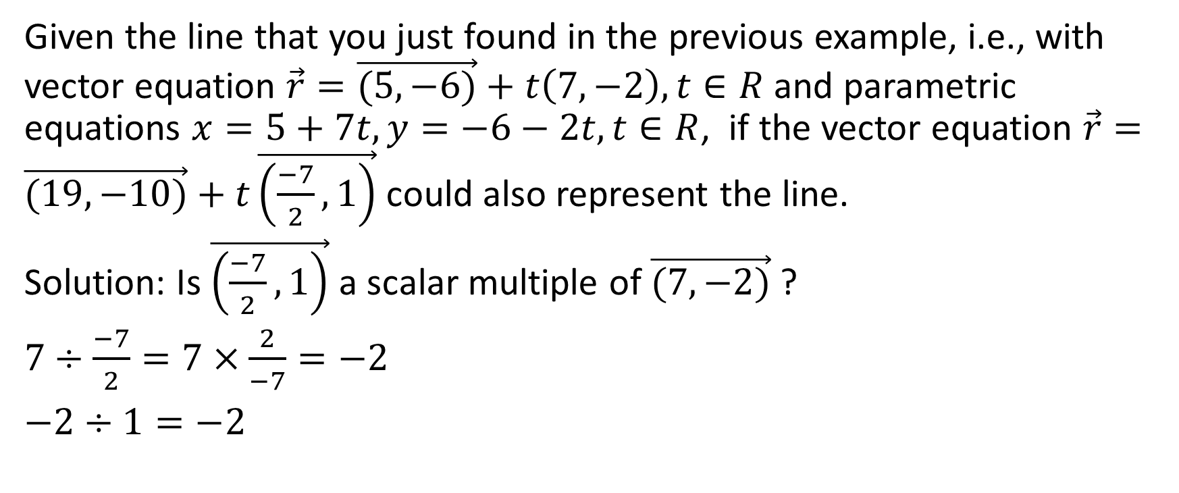
Given the line that you just found in the previous example, i.e., with vector equation $\vec{r}=\vec{(5,−6)}+t\left(7,−2\right),t∈R$ and parametric equations $x=5+7t,y=−6−2t,t∈R$, if the vector equation $\vec{r}=\vec{(19,−10)}+t\vec{\left(\frac{−7}{2},1\right)}$ could also represent the line.
Solution: Is $\vec{\left(\frac{−7}{2},1\right)}$ a scalar multiple of $\vec{(7,−2)}$ ?
$7÷\frac{−7}{2}=7×\frac{2}{−7}=−2$
$−2÷1=−2$

Slide 42
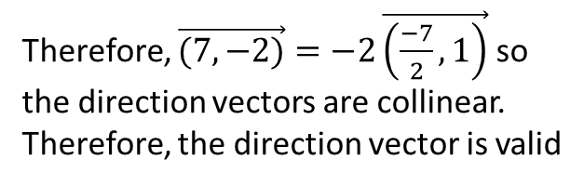
Given the line that you just found in the previous example, i.e., with vector equation $\vec{r}=\vec{(5,−6)}+t\left(7,−2\right),t∈R$ and parametric equations $x=5+7t,y=−6−2t,t∈R$, if the vector equation $\vec{r}=\vec{(19,−10)}+t\vec{\left(\frac{−7}{2},1\right)}$ could also represent the line.
Solution: Is $\vec{\left(\frac{−7}{2},1\right)}$ a scalar multiple of $\vec{(7,−2)}$ ?
$7÷\frac{−7}{2}=7×\frac{2}{−7}=−2$
$−2÷1=−2$
Therefore, $\vec{(7,−2)}=−2\vec{\left(\frac{−7}{2},1\right)}$ so the direction vectors are collinear. Therefore, the direction vector is valid

Slide 43
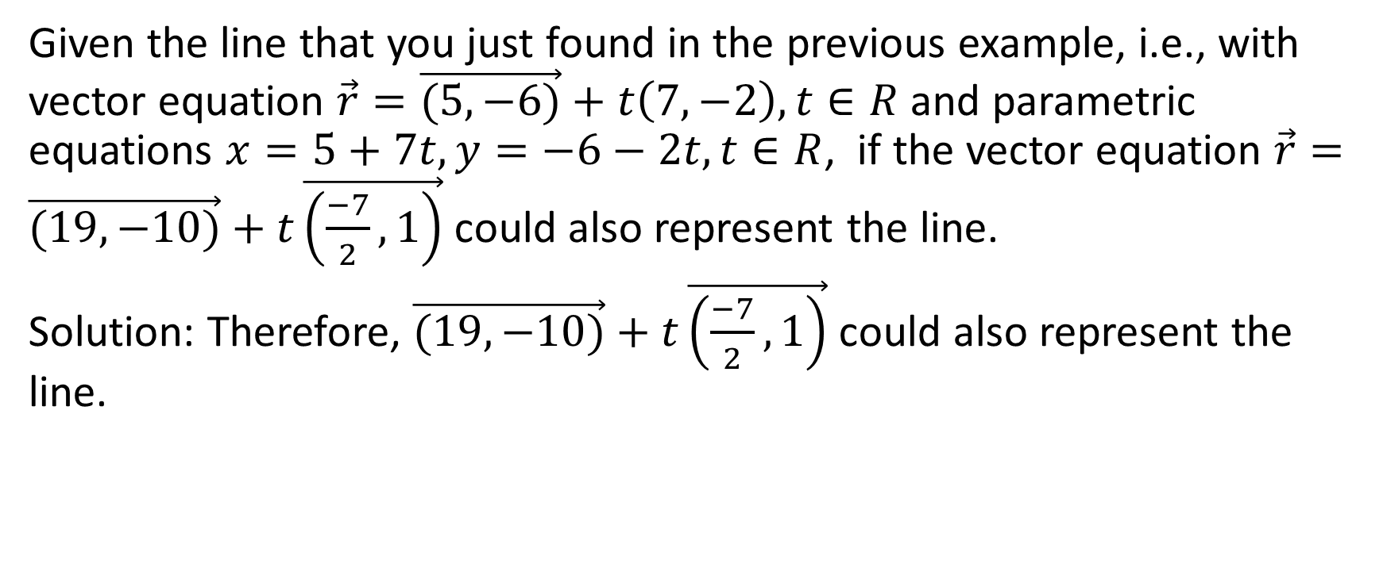
Given the line that you just found in the previous example, i.e., with vector equation $\vec{r}=\vec{(5,−6)}+t\left(7,−2\right),t∈R$ and parametric equations $x=5+7t,y=−6−2t,t∈R$, if the vector equation $\vec{r}=\vec{(19,−10)}+t\vec{\left(\frac{−7}{2},1\right)}$ could also represent the line.
Solution: Therefore, $\vec{(19,−10)}+t\vec{\left(\frac{−7}{2},1\right)}$ could also represent the line.

Slide 44

Example 3
Determine the equation of a line that is perpendicular to the line $\vec{r}=\vec{(5,−9)}+t\vec{(3,−5)}$ and that passes through the point (-5, -1).

Slide 45

Determine the equation of a line that is perpendicular to the line $\vec{r}=\vec{(5,−9)}+t\vec{(3,−5)}$ and that passes through the point (-5, -1).
Solution: Since the curve passes through the point (-5, -1), we can use the vector $\vec{(−5,−1)}$ as the position vector.

Slide 46
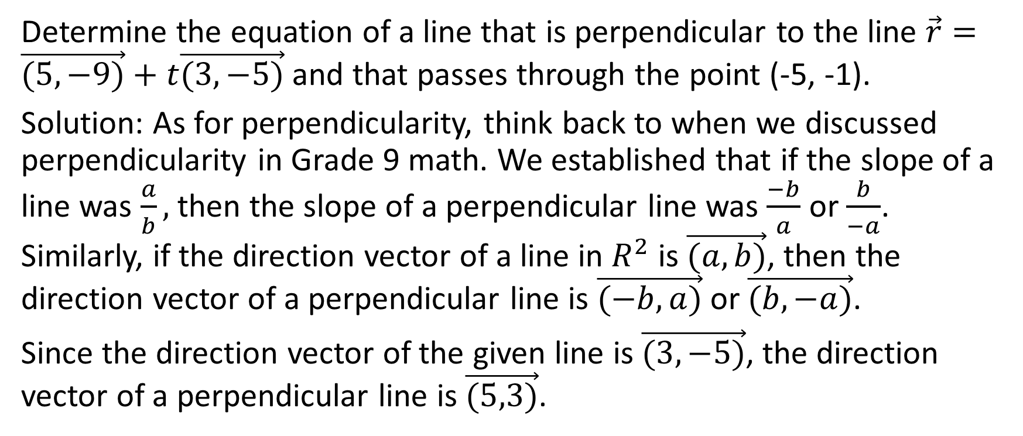
Determine the equation of a line that is perpendicular to the line $\vec{r}=\vec{(5,−9)}+t\vec{(3,−5)}$ and that passes through the point (-5, -1).
Solution: As for perpendicularity, think back to when we discussed perpendicularity in Grade 9 math. We established that if the slope of a line was $\frac{a}{b},$ then the slope of a perpendicular line was $\frac{−b}{a}$ or $\frac{b}{−a}$. Similarly, if the direction vector of a line in $R^{2}$ is $\vec{(a,b)}$, then the direction vector of a perpendicular line is $\vec{(−b,a)}$ or $\vec{(b,−a)}$.
Since the direction vector of the given line is $\vec{(3,−5)}$, the direction vector of a perpendicular line is $\vec{(5,3)}$.

Slide 47

Determine the equation of a line that is perpendicular to the line $\vec{r}=\vec{(5,−9)}+t\vec{(3,−5)}$ and that passes through the point (-5, -1).
Solution:
Therefore, the answer is $\vec{r}=\vec{(−5,−1)}+t\vec{(5,3)}$

